Slide 1
Automated Aquaponic Garden PLC Using a Web-based Interface
Ee-4910
Group 11
Chalmer Frueauf
Alex Gentry
Derrick Kaliney
Charles Witherspoon

Slide 2
Overview
Device Purpose
Design Scope
Market Analysis
Design Objectives and Assumptions
Design Requirements, Constraints, and Standards
Design Functionality
Design Impact
Documentation
Technical Approach
Hardware and Software
Tests and Evaluation
Critical Milestones and Time Schedule
Risks and Mitigation
References
Contact Information

Slide 3
Device Purpose
Increase accessibility of small-scale aquaponic systems
Provide a tool for home gardeners to automate their aquaponic yields
Create a schedulable system of powered appliances
Allow remote access and monitoring of aquaponic operation
Improve efficiency of agricultural water consumption
Support self-sufficiency of private citizens

Slide 4
Design Scope
Access 8 independently controlled electrical outlets through a micro-computer that manages the outlets and hosts a web page, allowing verified users to direct power to the aquaponic electrical components
Allow users to run schedules on equipment, store and query data and logs, and optionally import open-source agricultural databases
Develop and build a dynamic, indoor, automated aquaponic garden that uses a web-based interface to automate the system components

Slide 5
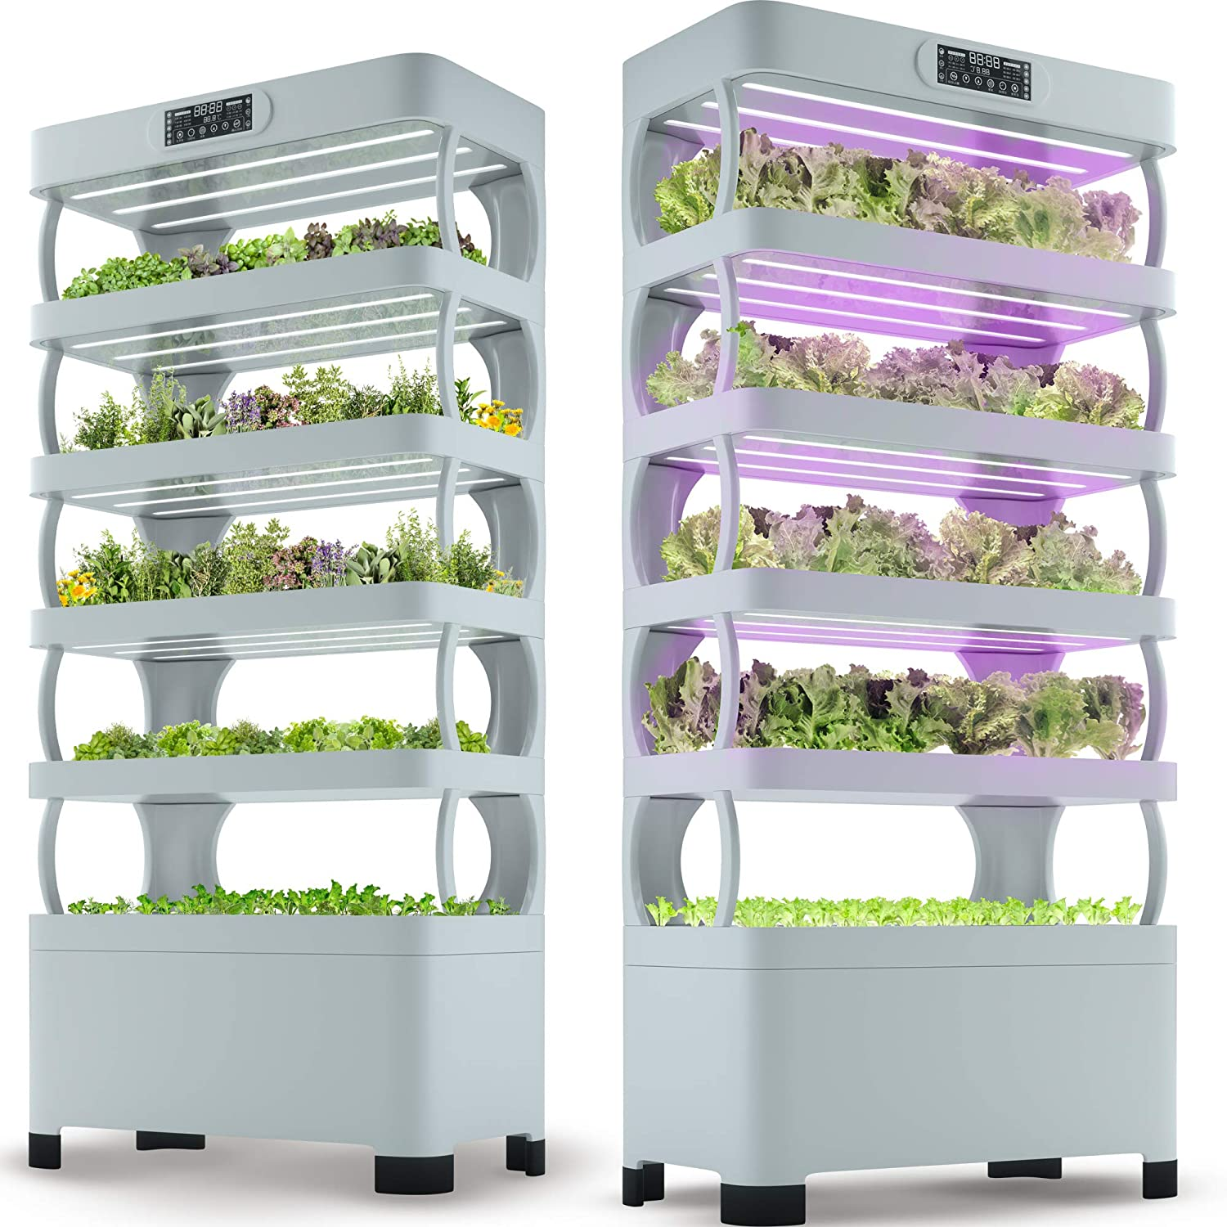
Market Analysis
A quick amazon search for “aquaponic systems” yields many different products, such as this $1500 system:
Our budget is well below this price, able to grow up to 107 plants (rather than 72) and gives a slightly larger growing area.
Many additional, smaller scale products are also available that offer timers or emergency shutoffs for power strips

Slide 6
Design Objectives
Objective Prime: The designed invention becomes as integrated into the modern-day kitchen as an oven, refrigerator, and sink. The designed invention is a leader in automating the aquaponic industry.
1: Device allows users to independently operate 8 different outlets using remote access
2: Device senses when the livestock tank water level is low and stops operations until water is added to the required level
3: Device hosts a webpage that allows users to run automated scheduling for lights, aeration, and water pumps; store growth data; and log system modifications

Slide 7
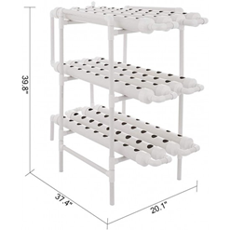
Design Objectives Cont.
4: Device communicates with a server to notify users of new software versions and grow data
5: Device includes a prototype aquaponic system to show functionality, using a pipe system that would allow for up to 107 plants:
  Size: 100x50x110cm/38"x19"x43" (of each pipe)
  Hole Size: 32mm
  Tube Diameter: 63mm
  Width: 19 in
  Length: 43 in

Slide 8
Design Assumptions
The product will:
Be powered by a GFCI compliant outlet
Provide power to 120V, three-prong appliances
Be used indoors, in a dry environment below 50% humidity
Be used between 40°F and 100°F
Be connected to an IEEE 802.11 wireless network
Be secured to a stable, flat surface with screws
Be used in conjunction with a fillable and drainable tank
Be used in compliance with provided instructions

Slide 9
Design Requirements
Device: Prototype:
Modify flow independently on 8 electrical sockets
Host a webpage to allow user interaction
Store growth and yield data, schedules, and system logs
Maintain system time to ensure accurate scheduled events
Use multiple water pumps, aeration devices, and light
Operate as a growth medium for various vegetation
Operate as an environment for aquatic livestock
Manage livestock tank water for distributing to grow beds

Slide 10
Design Requirements Cont.
Webpage:
Allow assignment of pre-selected or custom appliance types to individual outlets
Maintain independent daily schedules for individual sockets
Allow scheduling of outlets based on assigned type
Allow user settings for maximum and minimum operating water levels
Notify users via email of unscheduled changes to the system state
Allow users remote access to scheduling through a wide area network
Maintain password-verified identification of users with access to the system

Slide 11
Design Constraints
Device will be built using a Raspberry Pi board with SD card
A relay board will bridge between the outlets and the GPIO and will be scripted in Perl
System will have a maximum power consumption of 20 amps
Prototype will be built using a ~50-gallon storage tank
Device and prototype system will sum to less than $200USD in total cost

Slide 12
Design Standards
ISO/IEC 12207:2008 – Systems and software engineering – Software life cycle processes, ISO, 2008
ISO/IEC/IEEE 26511:2018 – Systems and software engineering – Requirements for managers of information for users of systems, software, and service, ISO/IEC JTC 1/SC 7, 2018
NEMA 5/IEC 60906-2:2011 – IEC system of plugs and socket-outlets for household and similar purposes, PEL/23, 2011
IEEE 802.11ac-2013 – IEEE Standard for Information technology – Telecommunications and information exchange between systems, C/LM, 2013
ISO – International Organization for Standardization
IEC – International Electrotechnical Commission
IEEE – Institute of Electrical and Electronics Engineers
NEMA – National Electrical Manufacturers Association
C/LM – LAN/MAN Standards Committee
LAN/MAN – Local Area Network and Metropolitan Area Network

Slide 13
Design Functionality
User Interface
  Allows user interactions with the system
    Interactions include logging data, setting schedules, monitoring plant growth, configuring associative devices
  Submits user data to the System API to process
System API
  Supplies an intermediary between the user interface, data store, and flow controller
  Processes data from the User Interface
  Stores data in the Data Store
  Actuates the Flow Controller

Slide 14
Design Functionality Cont.
Flow Controller
  Receives signal from system API and allows or denies current flow
  Alters the power being sent to different devices within the Aquaponic System
  Sends signals via GPIO to individual channels on an 8-channel relay board, altering current flow to the strip board socket
  Senses water level and shuts off specific sockets when pre-set conditions are not met
Data Store
  Stores data necessary to keep system functioning properly, such as system logs and scheduling data
Aquaponic System
  Supplies an environment for the growth of aquatic livestock, vegetation, and/or flowers for agricultural purposes

Slide 15
Design Impact
Cultural :
  Automated aquaponic systems being used in underdeveloped countries could affect the economy enough to see the country adopt new cultures or reevaluate current cultural norms
  These changes may be positive or negative
Economic:
  Farms could reduce the cost to operate which could lead to more profit
  Negatively, this larger profit margin could affect the amount of subsidies granted
Environmental:
  Lower water usage for agriculture, lower pesticide use, lower fertilizer runoff into public water tables, increase agricultural yield through layering, allows agriculture in barren areas
  Negative impacts would include trash from bad units; mitigations would include refurbishing units that went bad, stripping materials from bad units, and using safe e-waste methods

Slide 16
Design Impact Cont.
Global:
  Enough nutritious food, including some staple foods, for all the family year-round
  This includes extra food stocks for processing and sale to obtain income, and a reserve for special occasions or emergencies
  Sales from home garden produce can make a substantial contribution to a family's income
Public Health:
  With aquaponic systems, there is less usage of pesticides in general population's diets

Slide 17
Design Impact Cont.
Public Safety:
  No use of any toxic chemicals or fertilizers or pesticides
  A negative impact on growth of the plants is the effect of insect pests; pesticides are not a practical answer in dealing with problems with insects in aquaponic environments
Public Welfare:
  With a moderate initial cost and a low upkeep cost, a household aquaponic system can reduce the cost, and increase the supply, of fresh produce to the individual
  Negative impacts are potentially higher water and electricity utility costs per household
  Potential mitigations are efficient scheduling suggestions can help reduce the power draw of the system
Social:
  Inexpensive aquaponic systems can provide a more accessible and consistent source of healthy produce for the general public
  Negative impacts are that widely available aquaponic systems could reduce the demand for local and/or organic produce, adversely affecting orchards and farms
  Potential mitigations are farms could focus more heavily on produce that cannot be generated through aquaponics

Slide 18
User Documentation
This product will be delivered with a paper instruction manual included. The instruction manual will be a packet, written in English, covering the following:
Explanation of aquaponic process, goals, and benefits
Safety warnings and safety standards
Parts list of all provided components
Parts list of suggested components for building the non-electrical system
Instructions on both building the provided system and its suggested use
Instructions on connecting the processor to a wireless network
Instructions on access the built-in webpage and creating a user account
Instructions on function and use of the webpage, including troubleshooting, type assignment, scheduling, and settings
Examples of settings and their applications within the system
Limited product guarantee
Contact information for user support

Slide 19
Technical Approach
Hardware Decisions:
  Microcomputer: Raspberry Pi Model 3 A+ was chosen due to its wireless capabilities and processing speed
  Water Sensors: Adafruit and Seed sensors were chosen for their accuracy and ability to easy connect to the circuit board of the computer
  Relay Board: Elegoo relay board is the most cost-efficient and applicable component of the options for connecting the computer to the electrical sockets
  Electrical Sockets: Electrical sockets from Legrand fit the criteria best, based on the ability to modify the connection between individual sockets, and a significantly lower price
Software Decisions:
  Database: SQLite was chosen because it does not require a server to function, it handles storing and retrieving blob data, and the license is in the public domain
  Backend: For writing the operational code, which must be able to access the computer, the SQL database, and the webpage, PHP was chosen
  Frontend: For user interface portion of the software, JavaScript was chosen to create a webpage in the minimal Nevada style

Slide 20
Hardware
Circuit Board/Single-Board Computer
  To allow for new feature that enable/use 5 GHZ wireless and increased speed, this design is using Raspberry Pi Model 3 A+, with Raspberry Pi Zero WH (Zero W with Headers) as the runner up due to price
Water Sensor: Temperature
  The DS18B20 Digital Temperature Sensor from Adafruit is the most fitting temperature sensor overall. While it is not the least expensive, it does meet the requirements for integration with our Circuit Board and temperature range as specified in the Design Trades
Water Sensor: Water Level
  The Grove Water Level Sensor provides a cheap, accurate method of detecting the physical water level at any time. Unlike the float switch, which only senses 3 points (acceptable, high, low), it transmits constant data of the level relative to the sensor
Relay Board
  ELEGOO 8 Channel DC 5V Relay Module with Optocoupler, due to best fit with system design
Power Receptacles
  Legrand® TradeMaster® 15-Amp Light Almond Duplex Outlet 3232LACC30 due to price; we intend on getting 1 of the 15 Amp USB outlets to direct current to the raspberry pi

Slide 21
Itemized List
Raspberry Pi Model A 3+ will cost $25
DS18B20 Digital Temperature Sensor – Adafruit will cost $9.95
Grove Water Level Sensor – Seed will cost $6.95
ELEGOO 8 Channel DC 5V Relay Module with Optocoupler will cost $10.99
Legrand® TradeMaster® 15-Amp Light Almond Duplex Outlet 3232LACC30 .43 cents individually x 4 will cost $1.72
3-inch PVC Pipe (36 feet) will cost $14.99 x 4 will cost $60 (prototype)
Hub PVC Sewer and Drain Tee $3.78 individually x 6 will cost $22.68 (prototype)
3-inch Hub Long Turn 90 Degree PVC Sewer and Drain Street Elbow $3.52 x 12 will cost $42.24 (prototype)
PVC Vent Guard $3.55 individually x 3 will cost $10.65 (prototype)
Total: $190.18 ($54.61 Automated Aquaponic PLC ) ($135.57 prototype)

Slide 22
Software
Database
  SQLite is the optimal choice for this project. Although MariaDB meets many of the same requirements as SQLite, SQLite does not require a server to be running to access a database (database is instead stored in a file), allowing for quicker access and less processing power required. Additionally, SQLite is open-source and highly compatible with the Raspbian operating system
Backend Programming Language
  PHP is the language of choice due to it being the only language that satisfied requirement 11, matching the structure of existing solutions to backend software
Frontend Programming Language
  JavaScript does not meet requirement 32, however, due to limitations of PHP (i.e., client-side processing), JavaScript will be used
User Interface
  Nevada: Minimal One-page HTML Template was the best choice since the time needed to implement the user interface was simple and easy along with it being able to simplify the user interface with the system functions and supports the design of the entire system as well as easy navigation

Slide 23
Tests and Evaluation
Appropriate output of sockets will be tested under various conditions and states of the webpage
Appropriate output of sockets will be tested under various water levels
Web accessibility and persistence will be tested across multiple devices and browsers
Database accuracy will be tested through direct and automated data insertion
Proper appliance operation will be tested via visual confirmation
All tests will be performed at the site of construction at Wright State University, using tools available at the facility

Slide 24
Critical Milestones
Critical Milestones | Start by: | Done by:
Ordering and receiving parts | April 30, 2021 | August 23, 2021
Physical construction of PLC including power strip, outlets, and microprocessor | August 23, 2021 | September 6, 2021
Construction of prototype system | August 30, 2021 | September 6, 2021
Software development for functional webpage and demonstration of working user interface | August 30, 2021 | October 11, 2021
Software development of backend and database, with demonstration of information exchange between user and system | August 30, 2021 | October 18, 2021
Complete testing and evaluations of all systems | October 18, 2021 | November 14, 2021

Slide 25
Task | Assignee(s) | Wk1 | Wk2 | Wk3 | Wk4 | Wk5 | Wk6 | Wk7 | Wk8 | Wk9 | Wk10 | Wk11 | Wk12 | Wk13 | Wk14 | wk15
Combine Relay Board and Outlets | Derrick, Alex
Assemble Microcontroller GPIO | Chalmer, Charles
Construct Grow Beds, including PVC | Derrick, Chalmer
Structure Grow Beds onto Livestock Tanks | Derrick, Alex, Charles
Build Webpage Layout | Charles, Alex
Build Webpage Forms | Charles, Alex
Build User Login | Charles, Alex
Install Apache Server | Derrick, Chalmer
Build SQLite Database | Derrick, Chalmer
Interface PHP and JavaScript | Derrick, Charles
Build GPIO Library | Alex, Chalmer
Build Database Operations | Alex, Chalmer, Derrick
Manage Error Handling | Alex
Build Webpage Event Handling | Chalmer, Alex, Derrick
Test Webpage Interactions | Charles, Chalmer
Test Event Handling | Alex, Derrick
Test Database Function | Alex, Derrick
Combine PLC and Prototype | All

Slide 26
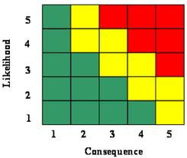
Risks and Mitigations
Risk 1: Budget and schedule are insufficient to complete construction of prototype system
Mitigation: Personal contributions and work outside of scheduled hours
Unmitigated Mitigated

Slide 27
Risks and Mitigations Cont.
Risk 2: Standards are unable to be met or kept
Mitigation: Documentation will be provided or sections of design will be reworked
Unmitigated Mitigated

Slide 28
Risks and Mitigations Cont.
Risk 3: Insufficient knowledge is required for aspects of software development
Mitigation: Additional research will be done and new sources will be found
Unmitigated Mitigated

Slide 29
References
https://www.instructables.com/Simple-and-intuitive-web-interface-for-your-Raspbe/
https://www.bbc.com/future/bespoke/follow-the-food/why-our-food-needs-to-use-less-water/?utm_source=pocket-newtabhttps://www.health.harvard.edu/blog/backyard-gardening-grow-your-own-food-improve-your-health-201206294984
http://www.fao.org/in-action/globefish/market-reports/resource-detail/en/c/1263851/
https://images-na.ssl-images-amazon.com/images/I/81StZVxm8JL._AC_SL1500_.jpg

Slide 30
Contacts
Chalmer Frueauf
Alex Gentry
Derrick Kaliney
Charles Witherspoon
frueauf.6@wright.edu
gentry.24@wright.edu
kaliney.2@wright.edu
witherspoon.7@wright.edu

